Slide 1
PAAC North Shore Extension: Design Review
On Track Trainwreck

Slide 2
System Overview

Slide 3
CTC Office

Slide 4
Moving Block Overlay
Purpose
Calculate the safe Moving Block speed and authority for each train.
Switch mode between Moving Block and Fixed Block operation.
Schedule Transit Operators.
Track Passenger Movement.
Requirements
The MBO is a vital controller.

Slide 5
MBO Use Cases

Slide 6
MBO Sequence Diagram

Slide 7
MBO Activity Diagram (only for modules with algorithms)

Slide 8
MBO Class Diagram

Slide 9
Train Model

Slide 10
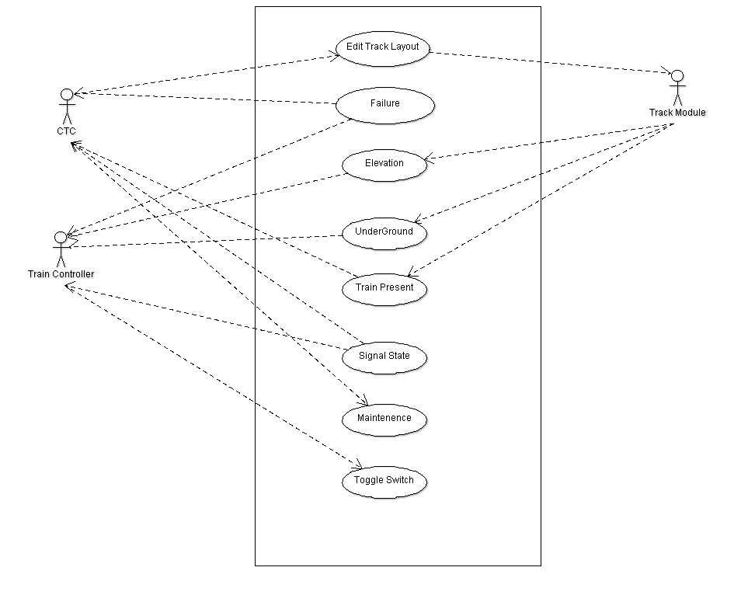
Train Controller: Use Cases

Slide 11
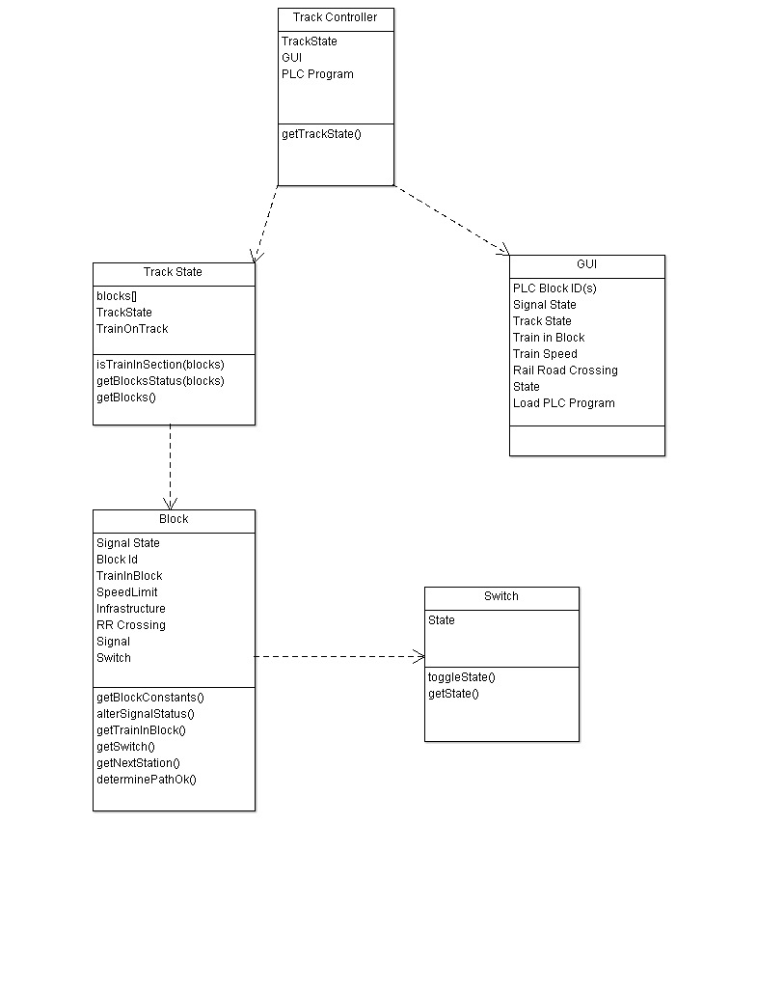
Train Controller: Class Diagram

Slide 12
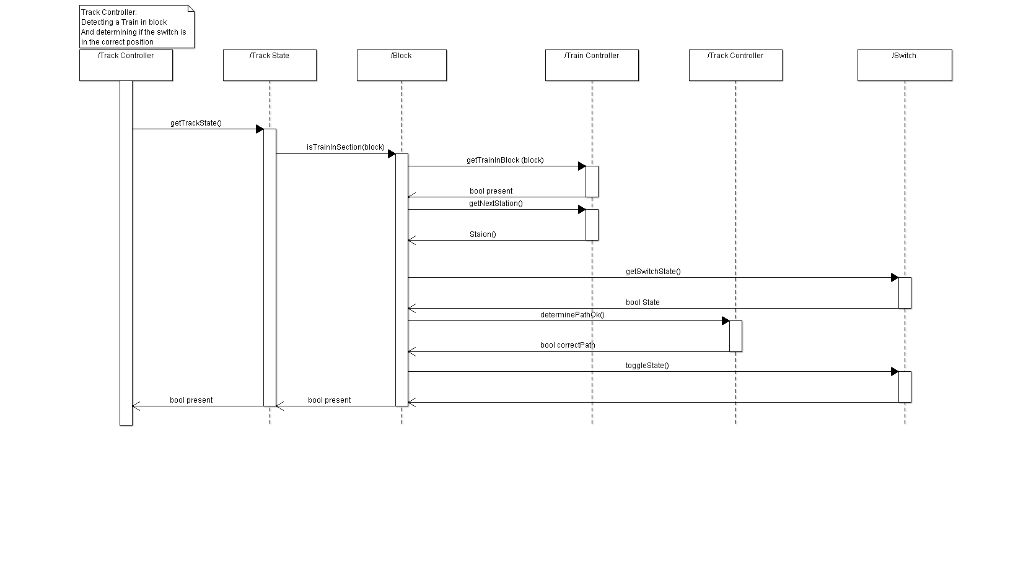
Train Controller: Sequence Diagram

Slide 13
Track Model

Slide 14
Track Controller

